Slide 1

Vidhyadhan Charitable Trust
SMT Z.S Patel College of Computer Application
Affiliated to, Veer Narmad South Gujarat University, Surat
Social Media Usage & Screen Time Analysis
Presented By. | Manani Suraj Vinodbhai - 5240 | Mandaliya Raj Manojbhai - 5241
Guided By. | Mrs. Dhvani Ma’am
Group No. | 11

Slide 2
Introduction
Social media is widely used for communication and entertainment.
People spend more time on screens daily.
Excessive screen time affects:
Sleep quality
Mental health
Productivity
This project analyzes user data to understand these effects.

Slide 3
Project Goals & Objectives
Analyze dataset of 50,000 users.
Identify usage patterns across age and occupation.
Study relation between:
Screen time
Stress levels
Sleep duration
Build ML models to:
Predict phone usage
Detect high stress users

Slide 4
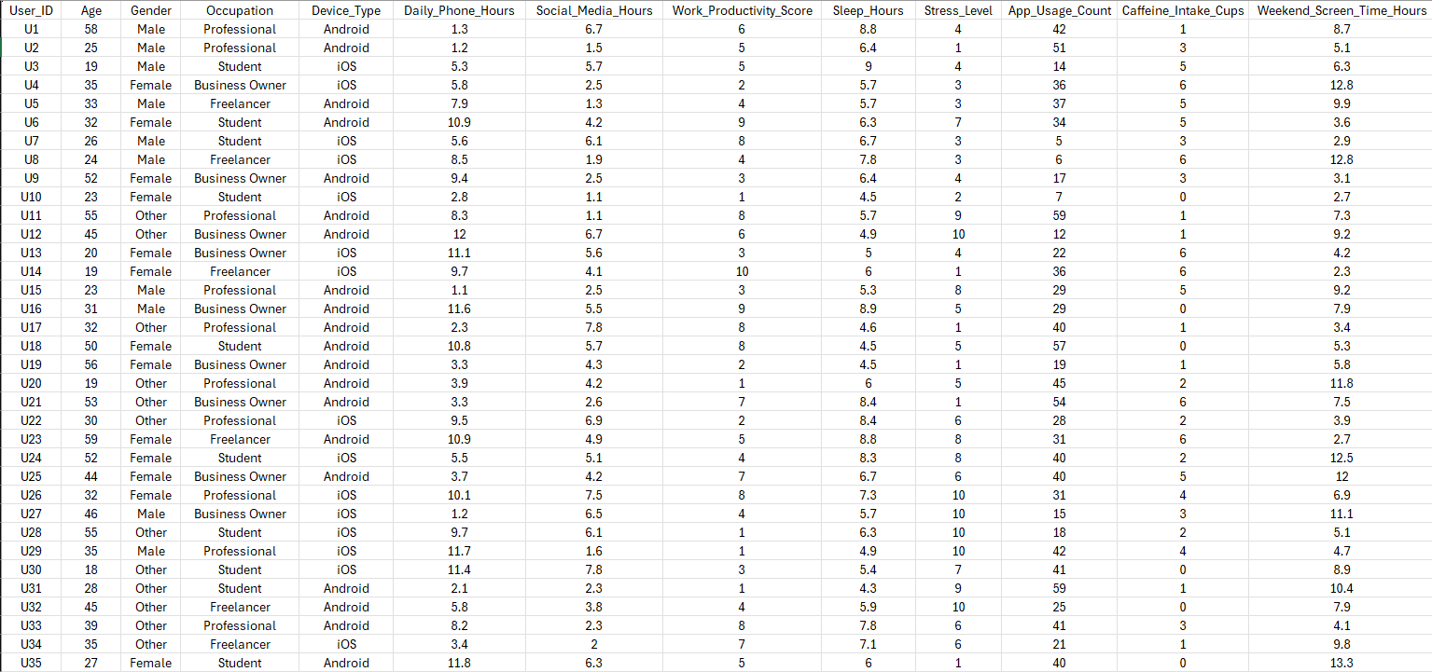
Dataset Overview
Dataset file: socialmedia_data.csv
Total Records: 50,000
Includes:
Demographics: Age, Gender, Occupation
Usage: Daily phone hours, social media usage
Lifestyle: Sleep hours, stress level
Device Type: Android, iOS, PC

Slide 5
Methodology & Tools
Libraries Used:
Pandas → Data cleaning & analysis.
Matplotlib & Seaborn → Data visualization.
Scikit-learn → Machine Learning.
Tools:
VS Code
Jupyter Notebook
Google Colab
Python

Slide 6
Data Cleaning & Preprocessing
Removed missing values (NULL).
Deleted duplicate records using User_ID.
Converted data into proper format.
Handled outliers for accurate results.

Slide 7
Feature Engineering
What is Feature Engineering?
Feature Engineering is the process of creating new features (columns) from existing data.
It helps improve data analysis and machine learning performance.
Converts raw data into meaningful insights.
Benefits of Feature Engineering:
Improves model accuracy.
Makes data easier to understand.
Helps find hidden patterns.
Enables better predictions.

Slide 8
Estimated Weekly Screen Time
High Stress Indicator (Binary Feature)
A new feature to calculate total weekly usage.
Why this is useful?
Gives a complete view of user screen time
More accurate than just daily usage
Example:
Daily = 4 hours
Weekend = 6 hours
Weekly = (4×5) + (6×2) = 32 hours
Formula Used:
Weekly Screen Time = (Daily Hours × 5) + (Weekend Hours × 2)
Created a new column to identify high stress. users.
Condition:
Stress Level ≥ 7 → High Stress (Yes).
Stress Level < 7 → Normal (No).
Why this is useful?
Converts complex data into simple categories
Helps in classification model (ML)
Example:
Stress = 8 → High Stress.
Stress = 5 → Normal

Slide 9
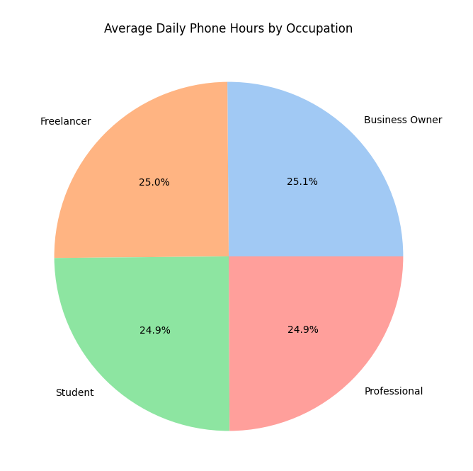
EDA 1 – Occupation vs Phone Usage
Compared phone usage across occupations.
Students and IT professionals use phones the most

Slide 10
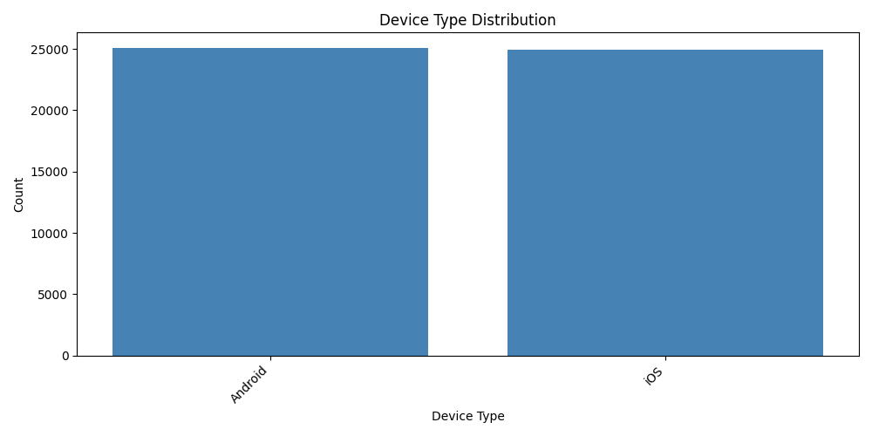
EDA 2 – Device & Age Trends
Device usage comparison:
Android vs iOS vs PC.
Age-based trends:
Young adults have highest usage.

Slide 11
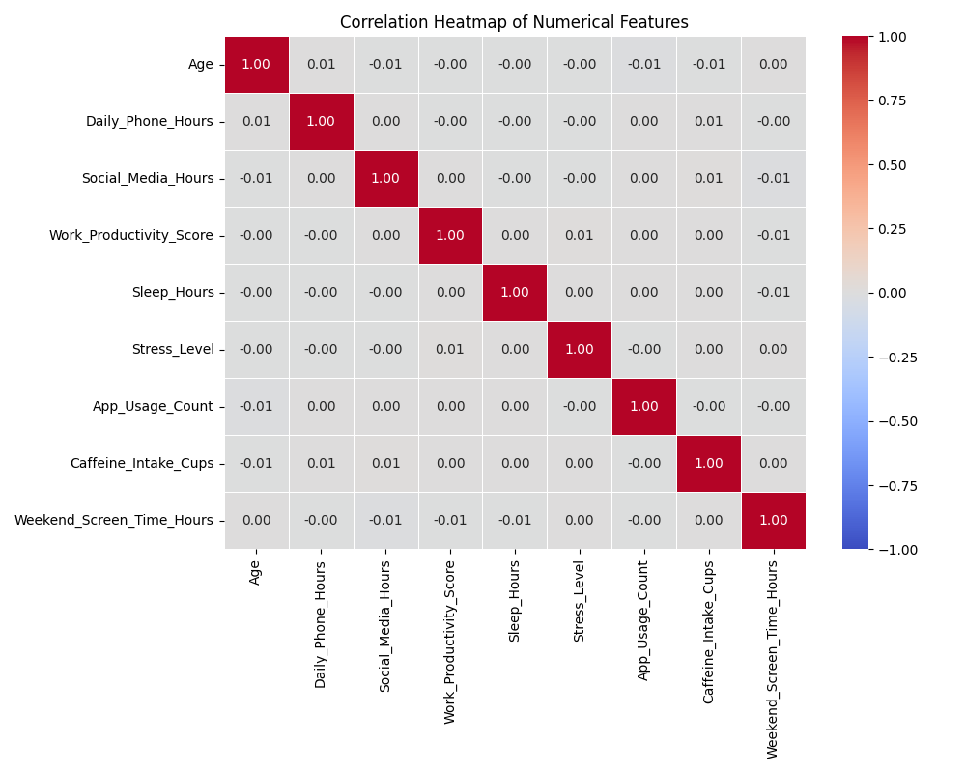
EDA 3 – Correlation Heatmap
Shows relationship between variables.
Key Insights:
More screen time → Less sleep.
More social media → Lower productivity.
Higher usage → Higher stress.

Slide 12
Machine Learning – Regression
Goal: Predict daily phone usage.
Model: Linear Regression.
Evaluation Metrics
Mean Squared Error (MSE).
R² Score.

Slide 13
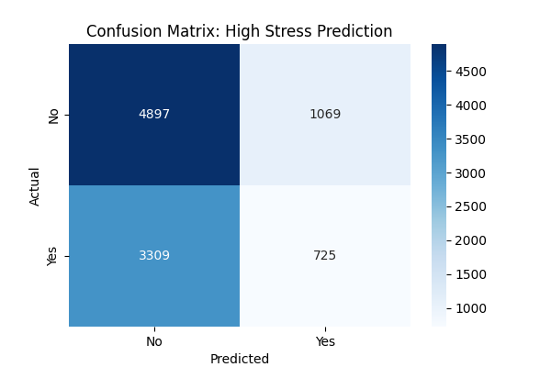
Machine Learning – Classification
Goal: Identify high stress users.
Model: Random Forest.
Output: Yes / No (High Stress)

Slide 14
Major Findings
High social media usage → Less sleep.
Weekend screen time is higher.
Heavy users show more stress.

Slide 15
Future Scope
Real-time screen tracking using apps.
Smart Alerts for:
Reducing screen time.
Improving mental health.
Integration with health monitoring systems.

Slide 16
Conclusion
Screen time affects lifestyle and health.
Data analysis helps understand user behaviour.
Can help people build healthier digital habits.

Slide 17
Thank You!

